Slide 1




Authentication
and Authorization

Slide 2
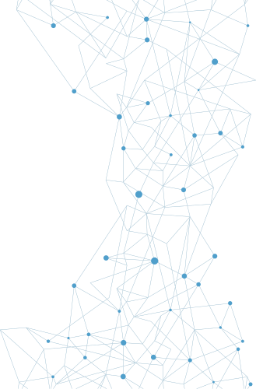

Authentication
Methods
Authentication is the process of verifying an identity previously established in a computer system.

Slide 3
Authentication
Methods
DIRECTORY SERVICES
A directory is a data storage mechanism similar to a database, but it has several distinct differences designed to provide efficient data-retrieval services compared to standard database mechanisms. A directory is designed and optimized for reading data, offering very fast search and retrieval operations.
The Lightweight Directory Access Protocol (LDAP) is commonly used to handle user authentication and authorization and to control access to Active Directory (AD) objects.

Slide 4
Authentication
Methods
FEDERATION
Federation, or identity federation, defines policies, protocols, and practices to manage identities across systems and organizations. Federation’s ultimate goal is to allow users to seamlessly access data or systems across domains.

Slide 5
Authentication
Methods
ATTESTATION
Attestation is the supplying of proof or evidence of some fact. In the case of authentication, attestation can be done by a service that checks the credentials supplied, and if they are correct and match the required values, the service can attest that the entry is valid or correct.

Slide 6
Authentication
Methods
TECHNOLOGIES
The Time-based One-Time Password (TOTP) algorithm is a specific implementation of an HOTP that uses a secret key with a current timestamp to generate a one-time password (OTP).
HMAC-based One-Time Password (HOTP) is an algorithm that can be used to authenticate a user in a system by using an authentication server.

Slide 7
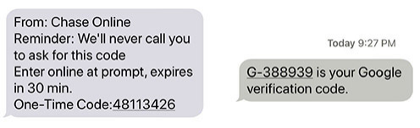
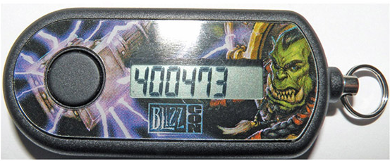
Authentication
Methods
TECHNOLOGIES
The use of Short Message Service (SMS), or text messaging, in a cell phone provides a second authentication factor that is sent to a preidentified number. The message that is sent provides a code that the user enters into the system.
Token keys are physical devices that carry a digital token used to identify the user. This is a “something you have” element in a multifactor authentication scheme.

Slide 8
Authentication
Methods
TECHNOLOGIES
Static codes are just that—codes that do not change, or are static in nature. There are many use cases where these are essential, such as devices without user intervention. Devices that do not have user intervention are widely deployed in many systems.
An authentication application functions by accepting user input, and if the user input is correct, it can pass the appropriate credentials to the system requesting authentication. This can be in the form of either a stored digital value or a one-time code in response to a challenge.

Slide 9
Authentication
Methods
TECHNOLOGIES
Push notification authentication supports user authentication by pushing a notification directly to an application on the user’s device. The user receives the alert that an authentication attempt is taking place, and they can approve or deny the access via the user interface on the application.
Another form of authenticating a user has an interaction with the system via a phone call. The authentication phone call is delivered from the authentication system to a specified phone number, which then can verify that the user is in possession of the actual mobile device.

Slide 10
Authentication
Methods
SMART CARDS
A smart card (also known as an integrated circuit card [ICC] or chip card) is a credit card–sized card with embedded integrated circuits that is used to provide identification security authentication.

Slide 11
Biometrics
Biometric factors are measurements of certain biological factors to identify one specific person from others. These factors are based on parts of the human body that are unique.

Slide 12
Biometrics
FINGERPRINT
A fingerprint scanner measures the unique pattern of a person’s fingerprint and translates that pattern into a numerical value, or template, as discussed in the previous section.

Slide 13
Biometrics
RETINA
A retinal scanner examines blood vessel patterns in the back of the eye. Believed to be unique and unchanging, the retina is a readily detectable biometric.

Slide 14
Biometrics
IRIS
An iris scanner works in a manner similar to a retinal scanner in that it uses an image of a unique biological measurement (in this case, the pigmentation associated with the iris of the eye). This can be photographed and measured from a distance, removing the psychological impediment of placing one’s eye up close to a scanner.

Slide 15
Biometrics
FACIAL
Facial recognition was mostly the stuff of sci-fi until it was integrated into various mobile phones. A sensor that recognizes when you move the phone into a position to see your face, coupled with a state of not being logged in, turns on the forward-facing camera, causing the system to look for its enrolled owner.

Slide 16
Biometrics
VOICE
Voice recognition is the use of unique tonal qualities and speech patterns to identify a person. Long the subject of sci-fi movies, this biometric has been one of the hardest to develop into a reliable mechanism, primarily because of problems with false acceptance and rejection rates, which will be discussed a bit later in the chapter

Slide 17
Biometrics
VEIN
A different biometric is the use of blood vein patterns to identify a user. Humans have a common vascular system, but the individual elements can vary in size and microstructure, and these fine-grained patterns are believed to be unique.

Slide 18
Biometrics
GAIT ANALYSIS
Gait analysis is the measurement of the pattern expressed by a person as they walk. An analysis of the gait, its length, the speed, and the rate of movement of specific points provides a unique signature that can be recorded and compared to previous samples.

Slide 19
Biometrics
EFFICACY RATES
The terms false acceptance rate (FAR) and false rejection rate (FRR) describe the chance that an incorrect user will be falsely accepted or a correct user will be falsely rejected, respectively
The false acceptance rate (FAR) determines what level of false positives is allowed in the system
The false rejection rate (FRR) determines what level of false negatives, or rejections, are going to be allowed in the system.

Slide 20
Multifactor Authentication
FACTORS
Factors are the specific elements that comprise an item of proof. These items can be grouped into three classes: something you know (passwords), something you have (token), and something you are (biometrics).

Slide 21
Multifactor Authentication
ATTRIBUTES
Attributes are collections of artifacts, like the factors previously presented, but rather than focus on the authentication item, they focus on elements associated with the user.
Somewhere you are
Something you can do
Something you exhibit
Someone you know

Slide 22
AAA
AUTHENTICATION
Authentication is the process of verifying an identity previously established in a computer system. There are a variety of methods for performing this function, each with its advantages and disadvantages

Slide 23
AAA
AUTHORIZATION
Authorization is the process of permitting or denying access to a specific resource. Once identity is confirmed via authentication, specific actions can be authorized or denied.

Slide 24
AAA
ACCOUNTING
Accounting is the process of ascribing resource usage by account for the purpose of tracking resource utilization. This is a basic accounting function that is still used by some enterprises.

Slide 25
Cloud vs On-Premises
Authentication to cloud versus on-premises requirements is basically a revisiting of the identity and authentication problem all over again.
When establishing either a cloud or on-premises system, you use identity and authentication as the foundation of your security effort.

Slide 26
Thank
You

